Slide 1
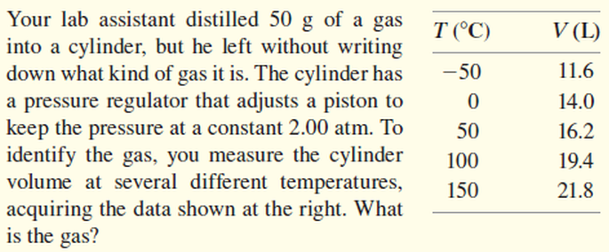
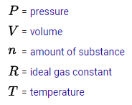
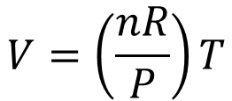



Ideal Gas Law
$$PV=nRT$$
$$V=\left(\frac{nR}{P}\right)T$$
constant
$$y=mx$$
constant
constant
$$V=\left(m\right)T$$
constant

Slide 2
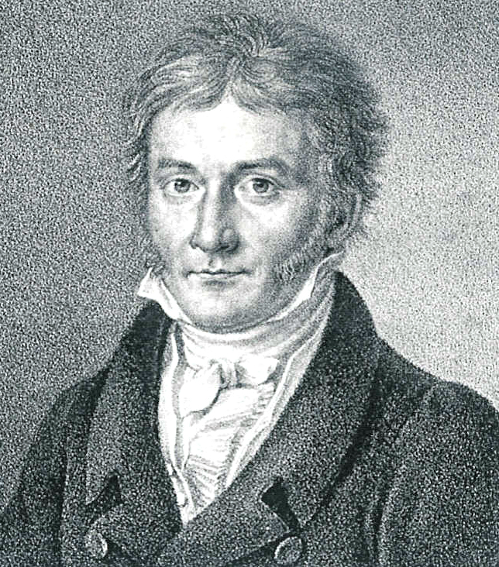
Method of Least Squares
$$Minimize S= \sum_{i=1}^{n}{{\left[y_{i}−\left(ax_{i}^{2}+bx_{i}+c\right)\right]}^{2}}$$
Carl Friedrich Gauss
(1977-1855)
$$\left(y−{ax}^{2}−bx−c\right)\left(y−{ax}^{2}−bx−c\right)$$
$$y^{2}−ax^{2}y−bxy−cy$$
$$−ax^{2}y +a^{2}x^{4}+abx^{3}+acx^{2}$$
$$−bxy +abx^{3} +b^{2}x^{2}+bcx$$
$$−cy +acx^{2} +bcx+c^{2}$$
$$S=y^{2}−2ax^{2}y−2bxy−2cy+a^{2}x^{4}+2abx^{3}+2acx^{2}+b^{2}x^{2}+2bcx+c^{2}$$
Note: we will set aside the summation operator for now…

Slide 3
Method of Least Squares
$$Minimize S= \sum_{i=1}^{n}{{\left[y_{i}−\left(ax_{i}^{2}+bx_{i}+c\right)\right]}^{2}}$$
This is just a system of 3 linear equations and 3 unknowns!
$$\left(\sum{x_{i}^{4}}\right)a+\left(\sum{x_{i}^{3}}\right)b+\left(\sum{x_{i}^{2}}\right)c = \left(\sum{x_{i}^{2}y_{i}}\right)$$
$$\left(\sum{x_{i}^{3}}\right)a+\left(\sum{x_{i}^{2}}\right)b+\left(\sum{x_{i}}\right)c = \left(\sum{x_{i}y_{i}}\right)$$
$$\left(\sum{x_{i}^{2}}\right)a+\left(\sum{x_{i}}\right)b+ \left(n\right)c = \left(\sum{y_{i}}\right)$$
Coefficient Matrix
Value Vector

Slide 4
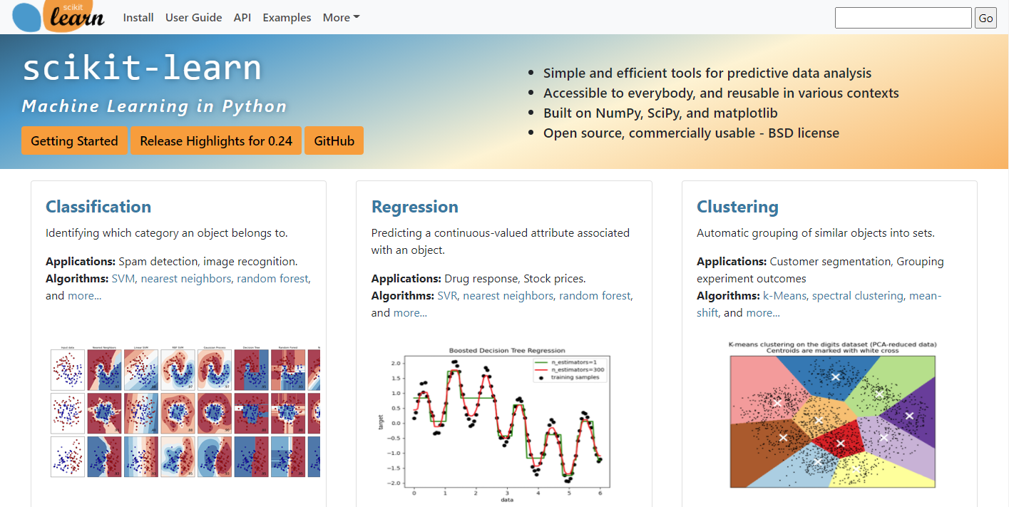
Machine Learning in Python
https://scikit-learn.org

Slide 5
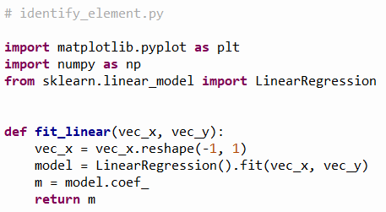
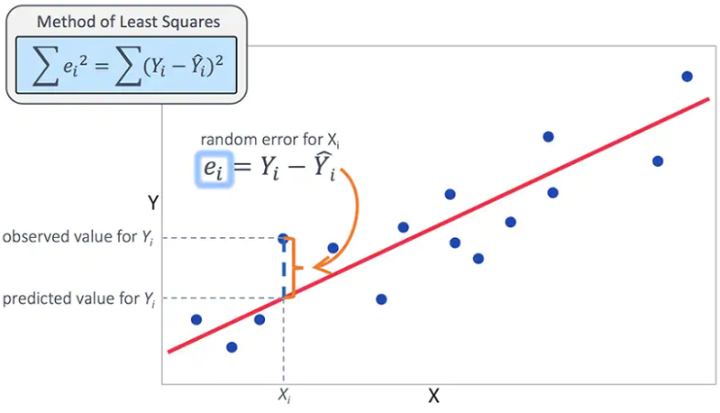
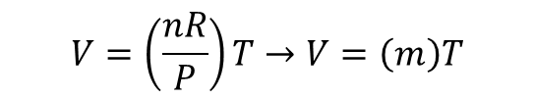
Open identify_element.py
Converts a 1-D array to a 2-D array
①
②
$$V=\left(\frac{nR}{P}\right)T→V=\left(m\right)T$$
③

Slide 6
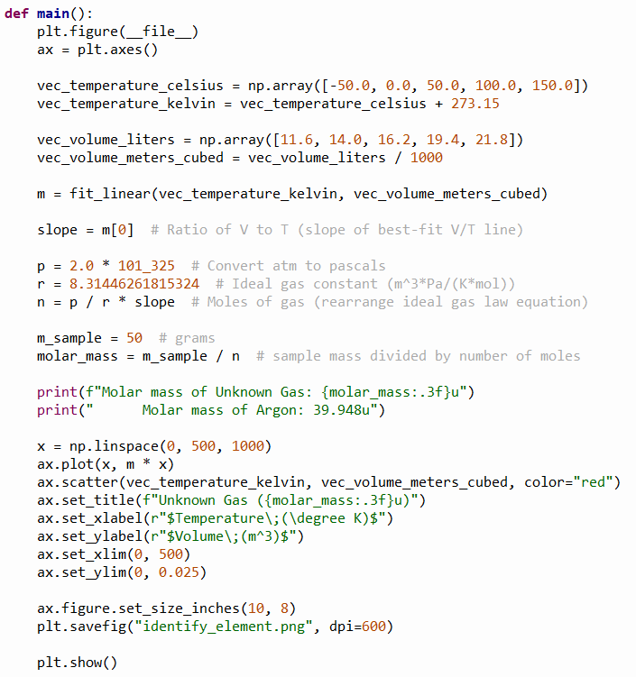

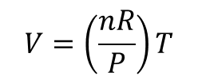


View identify_element.py
①
②
$$V=\left(\frac{nR}{P}\right)T$$
③
④
$$V=\left(m\right)T$$
⑤
$$m=\frac{nR}{P}→n=\frac{P}{R}(m)$$
⑦
⑥
⑧
⑨
⑩

Slide 7
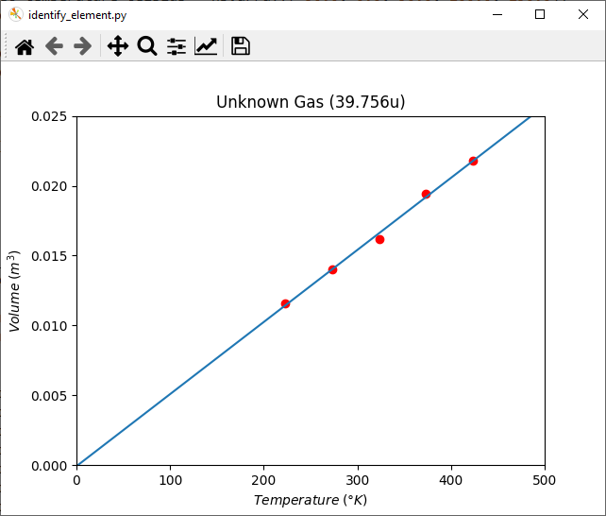

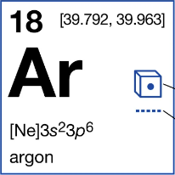
Run identify_element.py
Argon is the third-most abundant gas in Earth's atmosphere
It is 2x more abundant than water vapor
It is 23x more abundant than carbon dioxide

